Slide 1
10. Project Management

Slide 2
Review {Software Evolution}
Evolution Process
Legacy Systems
Software Maintenance

Slide 3
Unit 10: Software Management (7 Hrs.) Software Project Management; Project Management Activities (Project Planning, Risk Management, People Management, Reporting and Proposal Writing); Project Planning (Software Pricing, Plan-Driven Development, Project Scheduling, Estimation Techniques, COCOMO Cost Modeling); Introduction to Quality Management and Configuration Management

Slide 4
Advantages Project Management
Better control of financial, physical, and human resources
Improved customer relations
Shorter development times
Lower costs
Higher quality and increased reliability
Higher profit margins
Improved productivity
Better internal coordination
Higher worker morale

Slide 5
What is a project?
Some dictionary definitions:
“A specific plan or design”
“A planned undertaking”
“A large undertaking e.g. a public works scheme”
Notes:
Here are some definitions of ‘project’. No doubt there are other ones: for example
‘Unique process, consisting of a set of coordinated and controlled activities with start and finish dates, undertaken to achieve an objective conforming to specific requirements, including constraints of time, cost and resources’
BSO ISO 10006: 1997

Slide 6
What Is a Project?
A project is “a temporary endeavor undertaken to accomplish a unique product or service” (PMBOK® Guide 2000, p. 4)
Attributes of projects
unique purpose
temporary
require resources, often from various areas
should have a primary sponsor and/or customer
involve uncertainty

Slide 7
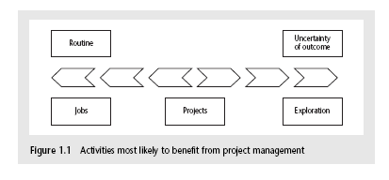
Jobs Vs projects
‘Jobs’ – repetition of very well-defined and well understood tasks with very little uncertainty
‘Exploration’ – e.g. finding a cure for cancer: the outcome is very uncertain
‘Projects’ – in the middle!

Slide 8
Characteristics of projects
A task is more ‘project-like’ if it is:
Non-routine
Planned
Aiming at a specific target
Work carried out for a customer
Involving several specialisms
Made up of several different phases
Constrained by time and resources
Large and/or complex
Notes:
Exercise 1.1 in the Software Project Management text is a good way of introducing this material if you have time. I have found this exercise to be a good ‘ice-breaker’. Get each student to list the example activities in an order which matches the degree to which they merit the description of ‘project’. You can create a grid on a whiteboard with the projects on the vertical axis and the positions 1st, 2nd, 3rd etc on the horizontal axis. You then go through asking how many put ‘producing a newspaper’ first, second, etc. (Avoid making jokes about this being like the Eurovision song contest). This is time-consuming but it does mean that every student participates in building up a general picture of people’s perceptions, and you can discuss disagreements in perceptions as you go along.

Slide 9
Software projects Vs other projects?
Same …but…
Invisibility
Complexity
Conformity
Flexibility
make software more problematic to build than other engineered artefacts.

Slide 10
What is Management?
Management can be defined as all activities and tasks undertaken by one or more persons for the purpose of planning and controlling the activities of others in order to achieve objectives or complete an activity that could not be achieved by others acting independently.
Management functions can be categorized as
Planning
Organizing
Staffing
Directing
Controlling

Slide 11
Management Functions
Planning Predetermining a course of action for accomplishing organizational Objectives
Organizing Arranging the relationships among work units for accomplishment of objectives and the granting of responsibility and authority to obtain those objectives
Staffing Selecting and training people for positions in the organization
Directing Creating an atmosphere that will assist and motivate people to achieve desired end results
Controlling Establishing, measuring, and evaluating performance of activities toward planned objectives

Slide 12
The Triple Constraint
Every project is constrained in different ways by its
Scope goals: What is the project trying to accomplish?
Time goals: How long should it take to complete?
Cost goals: What should it cost?
It is the project manager’s duty to balance these three often competing goals

Slide 13
Project Management
According to *PMI, PMBOK Guide 2003 “The application of knowledge, skills, tools and techniques to project activities in order to meet project requirements”
* The Project management Institute (PMI) is an independent professional society http://www.pmi.org

Slide 14
Project Management
Project management is a system of
management procedures,
practices,
technologies,
skills, and
experience
that are necessary to successfully manage a project.

Slide 15
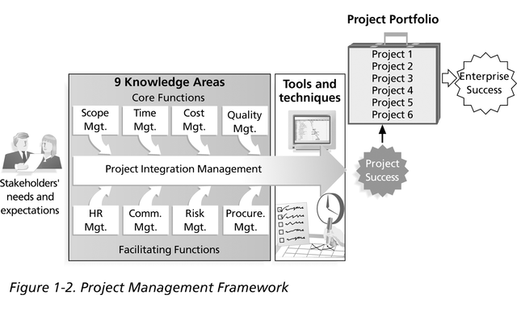
Project Management Framework

Slide 16
Project Management Tools and Techniques
Project management tools and techniques assist project managers and their teams in various aspects of project management
Some specific ones include
Project Agreement, scope statement, and WBS (work breakdown structure) (scope)
Gantt charts, network diagrams, critical path analysis, critical chain scheduling (time)
Cost estimates and earned value management (cost)

Slide 17
Software Project Management
Concerned with activities involved in ensuring that software is delivered:
on time
on schedule
in accordance with the requirements of the organization developing and procuring the software
Project management is needed because software development is always subject to budget and schedule constraints that are set by the organisation developing the software.

Slide 18
Project Management Activities
Proposal writing.
Project planning and scheduling.
Project costing.
Project monitoring and reviews.
Personnel selection and evaluation.
Report writing and presentations.

Slide 19
Proposal Writing
A proposal is an essential marketing document that helps cultivate an initial professional relationship between the vendor and the client
The proposal outlines the plan about the project, giving extensive information about the intention for implementing it, the ways to manage it and the results to be delivered from it
A proposal is a very important document. In some cases, a concept note precedes a proposal, briefing the basic facts of the project idea.
Besides, unless the ideas are not documented in writing, they do not exist. Hence, a proposal facilitates appropriate words for the conception of an idea

Slide 20
Proposal Writing
A proposal generally consists of:
Introduction: A brief overview of the problem, solution, costs, and benefits.
Issue: The main definition of the issue, including subject, purpose, main argument, background information and importance.
Solution: The main definition of the solution, including your step-by-step plan, the benefits, and how potential obstacles will be overcame.
Qualifications: Overview of the personnel required, experience.
Conclusion of the costs and benefits, and wrap-up: Balance the cost against the benefit, reinforce your point one last time.

Slide 21
Proposal Writing

Slide 22
Proposal Writing
Stages of Proposal writing
1. Identify and define your reader
2. Define the problem your proposal will solve
3. Define the solution
4. Conclusion: costs, benefits and wrap-up

Slide 23
Proposal Writing
1. Identify and define your reader
Just like with any kind of persuasion, it helps if you understand how to appeal to your audience.
Who will be reading your proposal and deciding if it’s accepted or rejected?
What do they care about?
What kind of language and benefits would resonate with them?
This is the first step because it’s an important thing to keep in mind as you go along and as information that informs the way you write from here on.

Slide 24
Proposal Writing
2. Define the problem your proposal will solve
Who: Who will the proposal affect?
What: What’s the reason for you to write the proposal in the first place?
Explain the current situation and the problems that come with it.

Slide 25
Proposal Writing
3. Define the solution
How: How are you going to solve the problem? Explain step-by-step in detail.
Who: Identify the personnel you need, along with their prior experience to add persuasion to the proposal
4. Conclusion: costs, benefits and wrap-up
Reiterate: The purpose and main argument
Costs: Break down the projected costs involved for different elements of the project
Benefits: Break down the benefits to the organization, monetary and non-monetary, to persuade the reader there’ll be a return on investment
Thanks: Thank the reader for their time.
Contact information: Where can the reader get in touch with you? Make sure to be crystal clear to make the details easily discoverable.

Slide 26
Proposal Writing
What’s clear to you might not always be clear to other people.
So, there are a few checks to run before you submit your proposal.
1. Check for jargon (then destroy it)
Although jargon is popular in the business world, not everyone shares the equal
love for it.
2. Change the passive voice to the active voice
The passive voice is defined as:
Ex.
Our troops defeated the enemy. Instead of
The enemy was defeated by our troops.
It’s a long-winded way of expressing something that could be expressed in simple terms.

Slide 27
Proposal Writing
3. Proofread the proposal
Install a tool like Grammarly and check the proposal in an online text editor.
These tools will manage to pick up on anything that is grammatically incorrect and sometimes even flags up stylistically poor phrases.
Poor spelling and grammar will only discredit the value of what you’re saying and could be a problem that leads to your proposal being rejected.

Slide 28
Project planning
Project planning involves breaking down the work into parts, assign these to project team members, allocate resources anticipate problems that might arise and prepare tentative solutions to those problems.
The project plan, which is created at the start of a project, is used to communicate how the work will be done to the project team and customers, and to help assess progress on the project.

Slide 29
Objectives of Planning
Providing project and resource schedules
Feasibility study
Resource allocation
Detailed costing
Motivation
coordination

Slide 30
When to Plan
Planning is an ongoing process of refinement
Each iteration becoming more detailed and more accurate than the last one
Over successive iteration, the emphasis and purpose of planning will shift
time, risks, resource availability, cash flow control

Slide 31
Scheduling
‘Time is nature’s way of stopping everything happening at once’
Having
worked out a method of doing the project
identified the tasks to be carried
assessed the time needed to do each task
need to allocate dates/times for the start and end of each activity
Notes:
Point out to students (if you are in the United Kingdom at least) that the UK English pronunciation of schedule is ‘shedule’ and that ‘skedule’ is the US pronunciation!

Slide 32
Project Schedules
A project schedule is a detailed project plan showing dates when each activity should start and finish
Also includes when and how much resource will be required
Creating a project schedule includes four stages:
Constructing an ideal activity plan
Risk analysis
Resource allocation
Schedule production

Slide 33
Project Schedules {Contd..}
Constructing an ideal activity plan
What activities need to be carried out and in what order
Risk analysis
Identifying potential problems
Resource allocation
The availability of resources may define when certain activities can be carried out or not
Schedule production

Slide 34
Projects and Activities
A project is composed of a number of interrelated activities
A project may start when at least one of its activities is ready to start
A project will be completed when all of the activities are completed
An activity must have a clearly defined start and an end-point
If an activity requires a resource then that resource requirement must be forecastable
The duration of an activity must be forecastable
There can be dependency among different activities

Slide 35
Identifying activities
Work-based: draw-up a Work Breakdown Structure listing the work items needed
Product-based approach
list the deliverable and intermediate products of project – product breakdown structure (PBS)
Identify the order in which products have to be created
work out the activities needed to create the products
Notes:
Section 6.5 of the textbook provides more details are examples

Slide 36
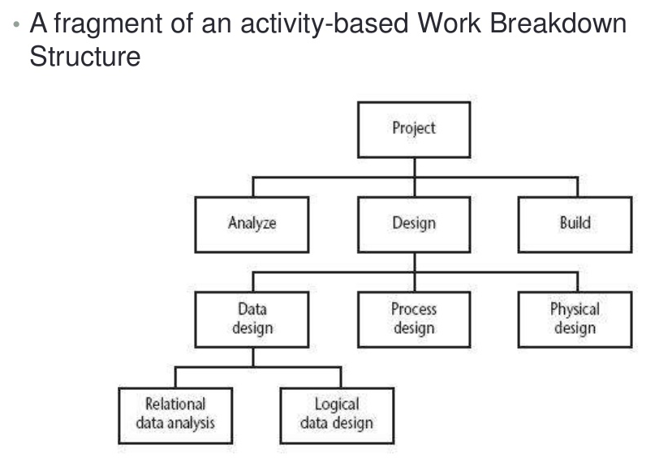
Identifying activities {Contd..}

Slide 37
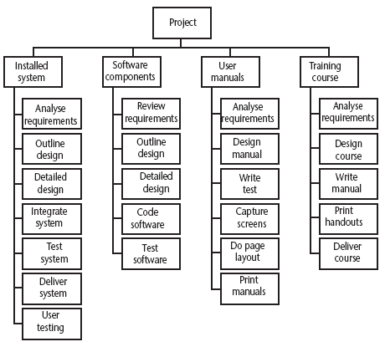
Identifying activities {Contd..}
A Work Breakdown Structure based on deliverables
Notes:
The IBM MITP approach suggested the following 5 levels
Level 1: Project
Level 2: Deliverables
Level 3: Components – which are key work items needed to produce the deliverables
Level 4: Work packages: groups of tasks needed to produce the components
Level 5: Tasks

Slide 38
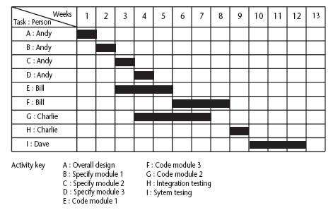
The final outcome of the planning process
A project plan as a bar chart

Slide 39
PERT and CPM
PERT (Program Evaluation Review Technique)
Do B
Do A
Do D
Do C
CPM (Critical Path Method)
Do B
Do A
Do D
Do C
Notes:
PERT was devised to support the development of the Polaris missile in the late 1950’s. CPM was developed by Du Pont Chemical Company who published the method in 1958.
PERT is an activity-on-node notation – the ‘nodes’ are the boxes which represent activities
CPM uses an activity-on-arrow notation where the arrows are the activities.
The approached described here is based on PERT but the other approach is described in the textbook as well – see Section 6.16

Slide 40
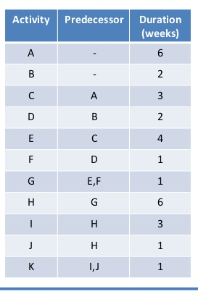
CPM Example
Notes:
PERT was devised to support the development of the Polaris missile in the late 1950’s. CPM was developed by Du Pont Chemical Company who published the method in 1958.
PERT is an activity-on-node notation – the ‘nodes’ are the boxes which represent activities
CPM uses an activity-on-arrow notation where the arrows are the activities.
The approached described here is based on PERT but the other approach is described in the textbook as well – see Section 6.16

Slide 43
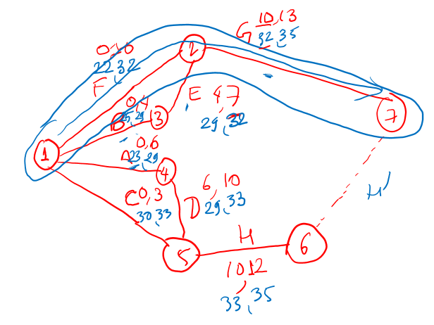

Slide 44
People Management
The process of
planning, organizing, directing (motivating), and controlling the procurement, development, compensation, integration, maintenance, and separation of organizational human resources
to the end that organizational, individual, and societal needs are satisfied.
Human Resource Management

Slide 45
Human Resource Management
Human Resource Management includes all activities used to attract & retain employees and to ensure they perform at a high level in meeting organizational goals.
These activities are made up of
1. Recruitment & selection.
2. Training and development.
3. Performance appraisal and feedback.
4. Pay and benefits.
5. Labor relations.

Slide 46
Human Resource Planning
HR Planning includes all activities managers do to forecast current and future HR needs.
Must be done prior to recruitment and selection
Demand forecasts made by managers estimate the number & qualifications the firm will need.
Supply forecasts estimate the availability and qualifications of current workers and those in the labor market.

Slide 47
HRM Components
Component should be consistent with the others, organization structure, and strategy.
Recruitment: develop a pool of qualified applicants.
Selection: determine relative qualifications & potential for a job.
Training & Development: ongoing process to develop worker’s abilities and skills.
Performance appraisal & feedback: provides information about how to train, motivate, and reward workers.
Managers can evaluate and then give feedback to enhance worker performance.
Pay and Benefits:
high performing employees should be rewarded with raises, bonuses.
Increased pay provides additional incentive.
Benefits, such as health insurance, reward membership in firm.

Slide 48
Recruitment
External recruiting: managers look outside the firm for people who have not worked at the firm before.
Managers advertise in newspapers, hold open houses, recruit at universities, and on the Internet.
External recruitment is difficult since many new jobs have specific skill needs.
A multi-prong approach to external recruiting works best.
Internal Recruiting: positions filled within the firm.
Internal recruiting has several benefits:
Workers know the firm’s culture, may not have new ideas.
Managers likely already know the candidates.
Internal advancement can motivate employees.

Slide 49
HRM Planning: Outsourcing
Outsourcing: managers can decide to contract with outside workers rather than hiring them.
Outsourcing is more flexible for the firm.
Outsourcing often provides human capital at a lower cost.
Outsource problems: managers lose control over output.
Outsource contractors are not committed to the firm.
Unions typically are against outsourcing that has potential to eliminate member’s jobs.

Slide 50
Selection Tools
Background
Information
Interviews
References
Selection
Performance tests
Paper tests
Physical
Ability tests

Slide 51
Selection Process
After a pool of applicants are identified, qualifications related to the job requirements are determined:
Background Information: includes education, prior employment, college major, etc.
Interview: almost all firms use one of two types:
Structured interview: managers ask each person the same job-related questions.
Unstructured interview: held like a normal conversation.
Usually structured interviews preferred; bias is possible.
Physical Ability Test: measure strength & endurance.
Good for physically demanding jobs.

Slide 52
Selection Process
Paper & Pencil Tests: Either an ability and personality test.
Ability test: assess if applicant has right skills for the job.
Personality test: seek traits relevant to job performance.
Be sure test is a good predictor of job performance.
Performance Tests: measure job performance.
Typing speed test is one example.
Assessment Center: candidates assessed on job-related activities over a period of a few days.
References: outside people provide candid information about candidate.
Can be hard to get accurate information.

Slide 53
Training & Development
Training: teach organizational members how to perform current jobs.
Help worker’s acquire skills to perform effectively.
Development: build worker’s skills to enable them to take on new duties.
Training used more often at lower levels of firm, development is common with managers.
A Needs Assessment should be taken first to determine who needs which program and what topics should be stressed.

Slide 54
Types of Development
Varied Work Experiences: Top managers must build expertise in many areas.
Workers identified as possible top managers given many different tasks.
Formal Education: tuition reimbursement is common for managers taking classes for MBA or similar.
Long-distance learning can also be used to reduce travel.
Whatever training and development efforts used, results must be transferred to the workplace.

Slide 55
Job Analysis
Job Analysis-the act of examining positions within an organization
Job Description-narrative explaining the scope of a position
Job Characteristics-tasks involved in a position
Job Requirements-personal characteristics necessary to fill a position

Slide 56
Performance Appraisal
Process of evaluating employee performance
job related strengths
development needs
progress toward goals
determine ways to improve performance
Pay an promotion decisions
Self Appraisal
Peer Appraisal
360 Degree appraisal

Slide 57
Who Appraises Performance?
Supervisors
Peers
Customers &
Clients
Sources of
performance
appraisals
Self
Subordinates

Slide 58
Pay and Benefits
Pay level: how the firm’s pay incentives compare to other firms in the industry.
Managers can decide to offer low or high relative wages.
Pay Structure: clusters jobs into categories based on importance, skills, and other issues.
Benefits: Some are required (social security).
Others (health insurance, day care, and others) are provided at the employers option.
Cafeteria-style plan: employee can choose the best mix of benefits for them. Can be hard to manage.

Slide 59
Incentives
Piece-Rate - Pay for each unit of output
Commissions - Pay from percentage of sales or profits
Bonuses - Lump sum payments
Merit Pay - Permanent increases in base pay linked to individual’s previous performance
Seniority - Increases over time
Gain Sharing - teams of employees share in gains from improvements in productivity or cost saving measures
Profit Sharing - A percentage of profits earned by a department or company

Slide 60
Labor Law
Minimum Wage
Pay for overtime
Social Security
Leaves and other benefits

Slide 61
Risk Management
A risk is a potential problem.
It’s an activity or event that may compromise the success of a software development project.
Identifying and aggregating risks is the only predictive method for capturing the probability that a software development project will experience unplanned events.
These include terminations, discontinuities, schedule delays, cost underestimation, and overrun of project resources

Slide 62
Risk Management
Risk management means risk containment and mitigation.
First, you’ve got to identify and plan.
Then be ready to act when a risk arises, drawing upon the experience and knowledge of the entire team to minimize the impact to the project.
Risk management includes the following tasks:
Identify risks and their triggers
Classify and prioritize all risks
Craft a plan that links each risk to a mitigation
Monitor for risk triggers during the project
Implement the mitigating action if any risk materializes
Communicate risk status throughout project

Slide 63
Risk Management
Identify and Classify Risks
Most software engineering projects are inherently risky because of the variety potential problems that might arise.
Experience from other software engineering projects can help managers identify and classify risk.
It is important precisely identify and describe all of the real threats to project success.
A simple but effective classification scheme is to arrange risks according to the areas of impact.

Slide 64
Risk Management
Identify and Classify Risks
New, unproven technologies
Ever-changing tools, techniques, protocols, standards, and development systems increase the probability that technology risks will arise in virtually any substantial software engineering effort.
The improper use of new technology most often leads directly to project failure.
User and functional requirements
The process of requirements definition is lengthy, tedious, and complex.
Moreover, requirements usually change with discovery, prototyping, and integration activities.
Change in requirements will likely propagate throughout the entire project, and modifications to user requirements might not translate to functional requirements.

Slide 65
Risk Management
Identify and Classify Risks
Application and system architecture
Taking the wrong direction with a platform, component, or architecture can have disastrous consequences.
As with the technological risks, it is vital that the team includes experts who understand the architecture and have the capability to make sound design choices.
Performance
It’s important to ensure that any risk management plan encompasses user and partner expectations on performance.
Organizational
Organizational problems may have adverse effects on project outcomes.
Project management must plan for efficient execution of the project, and find a balance between the needs of the development team and the expectations of the customers.
Adequate staffing and right team members with skill sets that are a good match with the project are the key to success.

Slide 66
Risk Management
Risk Management Plan
After cataloging all of the risks according to type, the software development project manager should craft a risk management plan.
As part of a larger, comprehensive project plan, the risk management plan outlines the response that will be taken for each risk.

Slide 67
Risk Management
Monitor and Mitigate
To be effective, software risk monitoring has to be integral with most project activities. Essentially, this means frequent checking during project meetings and critical events.
Monitoring includes:
Publish project status reports and include risk management issues
Revise risk plans according to any major changes in project schedule
Review and reprioritize risks, eliminating those with lowest probability
Brainstorm on potentially new risks after changes to project schedule or scope
When a risk occurs, the corresponding mitigation response should be taken from the risk management plan.

Slide 68
Risk Management
Monitor and Mitigate
Mitigation includes:
Accept:
Acknowledge that a risk is impacting the project.
Make an explicit decision to accept the risk without any changes to the project.
Avoid:
Adjust project scope, schedule, or constraints to minimize the effects of the risk.
Control:
Take action to minimize the impact or reduce the intensification of the risk.
Transfer:
Implement an organizational shift in accountability, responsibility, or authority to other stakeholders that will accept the risk.
Continue Monitoring:
Often suitable for low-impact risks, monitor the project environment for potentially increasing impact of the risk.

Slide 69
Risk Management
Communicate
Throughout the project, it’s vital to ensure effective communication among all stakeholders, managers, developers, QA.
Sharing information and getting feedback about risks will greatly increase the probability of project success.

Slide 70
Quality management
Concerned with ensuring that the required level of quality is achieved in a software product.
Three principal concerns:
At the organizational level, quality management is concerned with establishing a framework of organizational processes and standards that will lead to high-quality software.
At the process level, quality management involves the application of specific quality processes and checking that these planned processes have been followed.
At the project level, quality management is also concerned with establishing a quality plan for a project. The quality plan should set out the quality goals for the project and define what processes and standards are to be used.

Slide 71
Quality management activities
Quality management provides an independent check on the software development process.
The quality management process checks the project deliverables to ensure that they are consistent with organizational standards and goals
The quality team should be independent from the development team so that they can take an objective view of the software. This allows them to report on software quality without being influenced by software development issues.

Slide 72
Quality planning
A quality plan sets out the desired product qualities and how these are assessed and defines the most significant quality attributes.
The quality plan should define the quality assessment process.
It should set out which organisational standards should be applied and, where necessary, define new standards to be used.

Slide 73
Quality plans
Quality plan structure
Product introduction;
Product plans;
Process descriptions;
Quality goals;
Risks and risk management.
Quality plans should be short, concise documents
If they are too long, no-one will read them.

Slide 74
Scope of quality management
Quality management is particularly important for large, complex systems. The quality documentation is a record of progress and supports continuity of development as the development team changes.
For smaller systems, quality management needs less documentation and should focus on establishing a quality culture.

Slide 75
Software quality
Quality, simplistically, means that a product should meet its specification.
This is problematical for software systems
There is a tension between customer quality requirements (efficiency, reliability, etc.) and developer quality requirements (maintainability, reusability, etc.);
Some quality requirements are difficult to specify in an unambiguous way;
Software specifications are usually incomplete and often inconsistent.
The focus may be ‘fitness for purpose’ rather than specification conformance.

Slide 76
Software fitness for purpose
Have programming and documentation standards been followed in the development process?
Has the software been properly tested?
Is the software sufficiently dependable to be put into use?
Is the performance of the software acceptable for normal use?
Is the software usable?
Is the software well-structured and understandable?

Slide 77
Software quality attributes
Safety | Understandability | Portability
Security | Testability | Usability
Reliability | Adaptability | Reusability
Resilience | Modularity | Efficiency
Robustness | Complexity | Learnability

Slide 78
Quality conflicts
It is not possible for any system to be optimized for all of these attributes – for example, improving robustness may lead to loss of performance.
The quality plan should therefore define the most important quality attributes for the software that is being developed.
The plan should also include a definition of the quality assessment process, an agreed way of assessing whether some quality, such as maintainability or robustness, is present in the product.

Slide 79
Process and product quality
The quality of a developed product is influenced by the quality of the production process.
This is important in software development as some product quality attributes are hard to assess.
However, there is a very complex and poorly understood relationship between software processes and product quality.
The application of individual skills and experience is particularly important in software development;
External factors such as the newness of an application or the need for an accelerated development schedule may impair product quality.

Slide 80
Software standards
Standards define the required attributes of a product or process. They play an important role in quality management.
Standards may be international, national, organizational or project standards.
Product standards define characteristics that all software components should exhibit e.g. a common programming style.
Process standards define how the software process should be enacted.

Slide 81
Importance of standards
Avoids repetition of past mistakes.
They are a framework for defining what quality means in a particular setting i.e. that organization’s view of quality.
They provide continuity - new staff can understand the organisation by understanding the standards that are used.

Slide 82
ISO 9001 standards framework
An international set of standards that can be used as a basis for developing quality management systems.
ISO 9001, the most general of these standards, applies to organizations that design, develop and maintain products, including software.
The ISO 9001 standard is a framework for developing software standards.
It sets out general quality principles, describes quality processes in general and lays out the organizational standards and procedures that should be defined. These should be documented in an organizational quality manual.

Slide 83
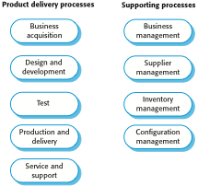
ISO 9001 core processes

Slide 84
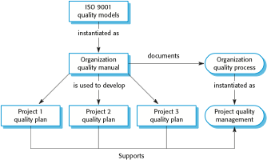
ISO 9001 and quality management

Slide 85
ISO 9001 certification
Quality standards and procedures should be documented in an organisational quality manual.
An external body may certify that an organisation’s quality manual conforms to ISO 9000 standards.
Some customers require suppliers to be ISO 9000 certified although the need for flexibility here is increasingly recognised.

Slide 86
CMM
The Capability Maturity Model (CMM) is a methodology used to develop and refine an organization's software development process.
The model describes a five-level evolutionary path of increasingly organized and systematically more mature processes.
CMM was developed and is promoted by the Software Engineering Institute (SEI)
The CMM is similar to ISO 9001
The main difference between the two systems lies in their respective purposes:
ISO 9001 specifies a minimal acceptable quality level for software processes, while the CMM establishes a framework for continuous process improvement

Slide 87
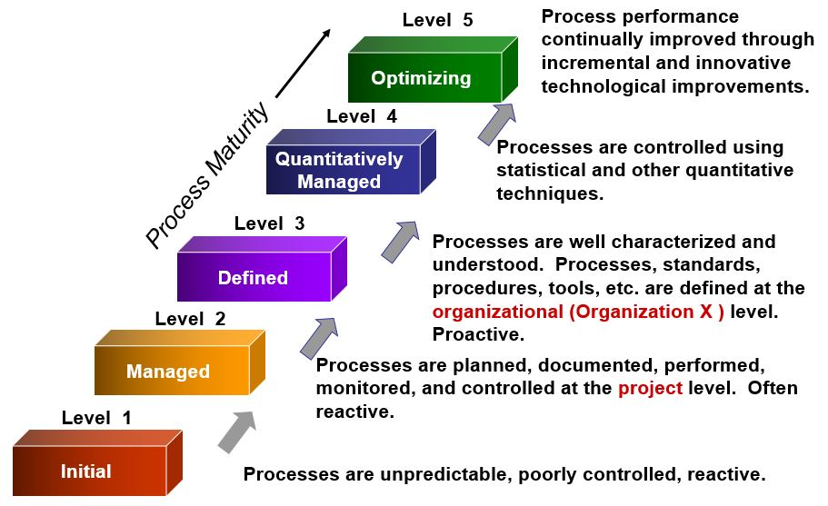
CMM

Slide 88
CMM
Maturity Levels of Software Processes
At the initial level, processes are disorganized, even chaotic. Success is likely to depend on individual efforts, and is not considered to be repeatable, because processes would not be sufficiently defined and documented to allow them to be replicated.
At the repeatable level, basic project management techniques are established, and successes could be repeated, because the requisite processes would have been made established, defined, and documented.

Slide 89
CMM
Maturity Levels of Software Processes
At the defined level, an organization has developed its own standard software process through greater attention to documentation, standardization, and integration.
At the managed level, an organization monitors and controls its own processes through data collection and analysis.
At the optimizing level, processes are constantly being improved through monitoring feedback from current processes and introducing innovative processes to better serve the organization's particular needs.

Slide 90
Software measurement and metrics
Software measurement is concerned with deriving a numeric value for an attribute of a software product or process.
This allows for objective comparisons between techniques and processes.
Although some companies have introduced measurement programmes, most organisations still don’t make systematic use of software measurement.
There are few established standards in this area.

Slide 91
Software metric
Any type of measurement which relates to a software system, process or related documentation
Lines of code in a program, the Fog index, number of person-days required to develop a component.
Allow the software and the software process to be quantified.
May be used to predict product attributes or to control the software process.
Product metrics can be used for general predictions or to identify anomalous components.

Slide 92
Use of measurements
To assign a value to system quality attributes
By measuring the characteristics of system components, such as their cyclomatic complexity, and then aggregating these measurements, you can assess system quality attributes, such as maintainability.
To identify the system components whose quality is sub-standard
Measurements can identify individual components with characteristics that deviate from the norm. For example, you can measure components to discover those with the highest complexity. These are most likely to contain bugs because the complexity makes them harder to understand.

Slide 93
Metrics assumptions
A software property can be measured.
The relationship exists between what we can measure and what we want to know. We can only measure internal attributes but are often more interested in external software attributes.
This relationship has been formalised and validated.
It may be difficult to relate what can be measured to desirable external quality attributes.

Slide 94
Configuration management
Configuration management (CM) is concerned with the policies, processes and tools for managing changing software systems.
CM is essential because it is easy to lose track of what changes and component versions have been incorporated into each system version.

Slide 95
Configuration Management activities
Change management
Keeping track of requests for changes to the software from customers and developers, working out the costs and impact of changes, and deciding the changes should be implemented.
Version management
Keeping track of the multiple versions of system components and ensuring that changes made to components by different developers do not interfere with each other.
System building
The process of assembling program components, data and libraries, then compiling these to create an executable system.
Release management
Preparing software for external release and keeping track of the system versions that have been released for customer use.

Slide 96
Configuration Management Terminology
Configuration item or software configuration item (SCI)
Anything associated with a software project (design, code, test data, document, etc.) that has been placed under configuration control.
There are often different versions of a configuration item
Configuration items have a unique name.
Configuration control
The process of ensuring that versions of systems and components are recorded and maintained so that changes are managed and all versions of components are identified and stored for the lifetime of the system.

Slide 97
Configuration Management terminology
Version
An instance of a configuration item that differs, in some way, from other instances of that item.
Versions always have a unique identifier, which is often composed of the configuration item name plus a version number
Workspace
area where software can be modified without affecting other developers who may be using
Baseline
Collection of component versions that make up a system.
Codeline
A codeline is a set of versions of a software component and other configuration items on which that component depends.

Slide 98
Configuration Management terminology
Mainline
A sequence of baselines representing different versions of a system
Release
A version of a system that has been released to customers (or other users in an organization) for use
Branching
The creation of a new codeline from a version in an existing codeline.
The new codeline and the existing codeline may then develop independently
Merging
The creation of a new version of a software component by merging separate versions in different codelines

Slide 99
Change management
Organizational needs and requirements change during the lifetime of a system, bugs have to be repaired and systems have to adapt to changes in their environment.
Change management is intended to ensure that system evolution is a managed process and that priority is given to the most urgent and cost-effective changes.
The change management process is concerned with analyzing the costs and benefits of proposed changes, approving those changes that are worthwhile and tracking which components in the system have been changed.

Slide 100
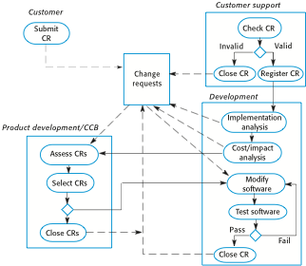
The change management process

Slide 101
The change management
Programmer’s Directory
(IEEE Std: “Dynamic Library”)
Completely under control of one programmer
Master Directory
(IEEE Std: “Controlled Library”)
Central directory of all promotions
Software Repository
(IEEE Std: “Static Library”)
Externally released baselines.
Promotion
Central source
code archive
Release
Foo’95
Foo’98

Slide 102
Version management
Version management (VM) is the process of keeping track of different versions of software components or configuration items and the systems in which these components are used.
It also involves ensuring that changes made by different developers to these versions do not interfere with each other.
Therefore version management can be thought of as the process of managing codelines and baselines.

Slide 103
Version management
Version Numbering
Normally these are <Major.Minor.Revision.Build>.
Where:
Major is a major update to the software
Minor is a small update to the software
Revision is any change made (bug fixes, small updates)
Build numbers are identifiers for a particular build
-- the actual attempt to compile and package whatever it is you are building.
Example (1.7.1.0):
Major version 1
Had 7 minor updates
First revision/bugfix
No build number

Slide 104
Version management Tools

Slide 105
System building
System building is the process of creating a complete, executable system by compiling and linking the system components, external libraries, configuration files, etc.
System building tools and version management tools must communicate as the build process involves checking out component versions from the repository managed by the version management system.
The configuration description used to identify a baseline is also used by the system building tool.

Slide 106
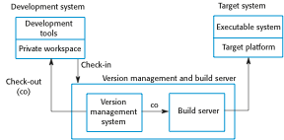
Development, build, and target platforms

Slide 107
Release management
A system release is a version of a software system that is distributed to customers.
For mass market software, it is usually possible to identify two types of release:
major releases which deliver significant new functionality
minor releases, which repair bugs and fix customer problems that have been reported.
For custom software or software product lines, releases of the system may have to be produced for each customer and individual customers may be running several different releases of the system at the same time.

Slide 108
Release tracking
In the event of a problem, it may be necessary to reproduce exactly the software that has been delivered to a particular customer.
When a system release is produced, it must be documented to ensure that it can be re-created exactly in the future.
This is particularly important for customized, long-lifetime embedded systems, such as those that control complex machines.
Customers may use a single release of these systems for many years and may require specific changes to a particular software system long after its original release date.

Slide 109
Release planning
As well as the technical work involved in creating a release distribution, advertising and publicity material have to be prepared and marketing strategies put in place to convince customers to buy the new release of the system.
Release timing
If releases are too frequent or require hardware upgrades, customers may not move to the new release, especially if they have to pay for it.
If system releases are too infrequent, market share may be lost as customers move to alternative systems.

Slide 110
Release components
As well as the the executable code of the system, a release may also include:
configuration files defining how the release should be configured for particular installations;
data files, such as files of error messages, that are needed for successful system operation;
an installation program that is used to help install the system on target hardware;
electronic and paper documentation describing the system;
packaging and associated publicity that have been designed for that release.

Slide 111
Software Pricing
Finding the right balance between value and revenue
your ability to help customers and be fairly compensated for that help
will make or break your company.
Undercharge, and you'll cripple your business with uncompensated development and delivery costs;
Overcharge, and you’ll suppress your growth and drive away thousands of would-be customers.

Slide 112
Software Pricing
Strategies
Flat rate pricing
Usage based pricing
Tiered pricing
Per user pricing
Per active user pricing
Per feature pricing
Freemium business model

Slide 113
Software Pricing
Flat rate pricing
Flat rate pricing is probably the simplest way to sell a Software solution
We offer a single product, a single set of features, and a single price.
Advantages
Easier to sell.
Easier to communicate.
Disadvantages
No regular revenue

Slide 114
Software Pricing
Usage based pricing
this type of pricing strategy directly relates the cost of a Software product to its usage: if you use more of the service, your bill goes up; use less, and your spend decreases.
Advantages
There are no big up-front costs with usage based pricing
Price scales alongside usage
Disadvantages
Harder to predict revenue/ customer costs

Slide 115
Software Pricing
Tiered pricing
this type of pricing strategy allows companies to offer multiple "packages", with different combinations of features offered at different price points.
Advantages
Appeal to multiple personas
When your customer outgrows their current package, there's a direct route to the next price point.
Disadvantages
Choices can quickly become overwhelming, and trying to decide between ten price tiers is a rapid route to an abandoned sale.

Slide 116
Software Pricing
Per user pricing
this type of pricing strategy depends upon number of users
Advantages
Simplicity
Predictable revenue generation
Disadvantages
By charging per user, you provide a reason to avoid adding new users to the tool. This also provides an incentive to cheat, and wherever possible, share a single login between multiple team members.

Slide 117
Software Pricing
Per active user pricing
this type of pricing strategy depends upon number of active users
Advantages
Customers only pay for active users.
Predictable revenue generation
Disadvantages
Per active user pricing doesn't offer extra incentive

Slide 118
Software Pricing
Per feature pricing
Per feature pricing separates out different pricing tiers according to the functionality available in each, with the higher priced packages associated with a greater number of available features.
Advantages
Per feature pricing offers a clear and obvious motivation for upgrading: you unlock extra functionality.
Disadvantages
How do you know which features your users will want? Getting the balance wrong can discourage adoption, as crucial features end up in overpriced tiers, or the bulk of your product's benefit ends up in your cheapest package.

Slide 119
Software Pricing
Freemium business model
this type of pricing strategy offers a free-to-use product, supplemented by additional paid packages.
Advantages
Easy to attract the customers.
Disadvantages
Freemium is a real revenue killer
If your product solves a painful, expensive problem for free, why would customer pay?

Slide 120
Software Pricing
Estimation Methods
In the early stage in a project it is very difficult to accurately estimate system development costs.
There is no simple way to make an accurate estimate of the effort required to develop software.
All of the techniques based on the experience of project managers who use their knowledge of previous projects to estimate of the resources required for the project.

Slide 121
Software Pricing
Estimation Methods
Expert Judgement
Domain experts are asked to estimate the project cost.
The estimation process iterates until an agreed estimate is reached.
Estimation by previous project
The cost of a new project is estimated by a completed project in the same application domain.
Application of Parkinson’s Law
Parkinson’s Law states that work expands to fill the time available and the cost is determined by the resources used.

Slide 122
Software Pricing
Estimation Methods
Pricing to win
The software cost is estimated by the price what the customer has available to spend on the project.
Algorithmic Cost Modeling
Relating some software metric a mathematical model is developed to estimate the project cost
COCOMO model

Slide 123
Software Pricing
COCOMO model
Empirical model based on project experience
Well-documented, independent model, Independent of a specific software vendor
Long history – initially published in 1981 (COCOMO-81) and last in 1999 (COCOMO-II)
COCOMO-II takes into account different approaches to software development, reuse, etc.
Three-level model that allows increasingly detailed estimates to be prepared as development progresses
Early prototyping level: Based on “application points”
Early design level: Based on “function points” later converted to LoC
Post-architecture level: Estimates based on LoC

Slide 124
Software Pricing
COCOMO model: Early Prototyping Level (Application Composition Model)
Supports prototyping projects and projects where there is extensive reuse
Estimates effort in application points/staff month
PM = ( NAP×(1 - %reuse/100 ) ) / PROD
PM – effort in person-months
NAP – number of application points
PROD – productivity

Slide 125
Software Pricing
COCOMO model: Early Design Level
This model is used in the early stages of a software project when very little may beknown about the size of the product to be developed, the nature of the target platform, the nature of the personnel to be involved in the project, or the detailed specifics of the process to be used.
Estimates made after requirements confirmed
Based on a standard formula for algorithmic models
PM = A ∗ Size ^{B} * M
M = PERS * RCPX ∗ RUSE * PDIF * PREX * FCIL ∗ SCED
A = 2.94 in initial calibration,
Size in KLOC,
B varies from 1.1 to 1.24 depending on novelty of the project, development flexibility, risk management approaches and the process maturity.

Slide 126
Software Pricing
COCOMO model: Early Design Level
Multipliers(M) reflect the capability of the developers, the non-functional requirements, the familiarity with the development platform, etc.
RCPX - product reliability and complexity;
RUSE - the reuse required;
PDIF - platform difficulty;
PREX - personnel experience;
PERS - personnel capability;
SCED - required schedule;
FCIL - the team support facilities.

Slide 127
Software Pricing
COCOMO model: Post Architecture Model
It is intended to be used when a software life-cycle architecture has been developed.
This model is used in the development and maintenance of software products
Uses the same formula as the early design model but with 17 rather than 7 associated multipliers.
PM = A ∗ Size ^{B} * M
The code size is estimated as:
Number of lines of new code to be developed;
Estimate of equivalent number of lines of new code computed using the reuse model;
An estimate of the number of lines of code that have to be modified according to requirements changes

Slide 128
Software Pricing
COCOMO model: Post Architecture Model
The exponent factor, B depends on 5 scale factors. Their sum/100 is added to 1.01
For example: A company takes on a project in a new domain. The client has not defined the process to be used and has not allowed time for risk analysis. The company has a CMM level 2 rating.
Precedenteness - new project (4)
Development flexibility - no client involvement - Very high (1)
Architecture/risk resolution - No risk analysis - V. Low .(5)
Team cohesion - new team - nominal (3)
Process maturity - some control - nominal (3)
Scale factor is therefore 1.17.

Slide 129
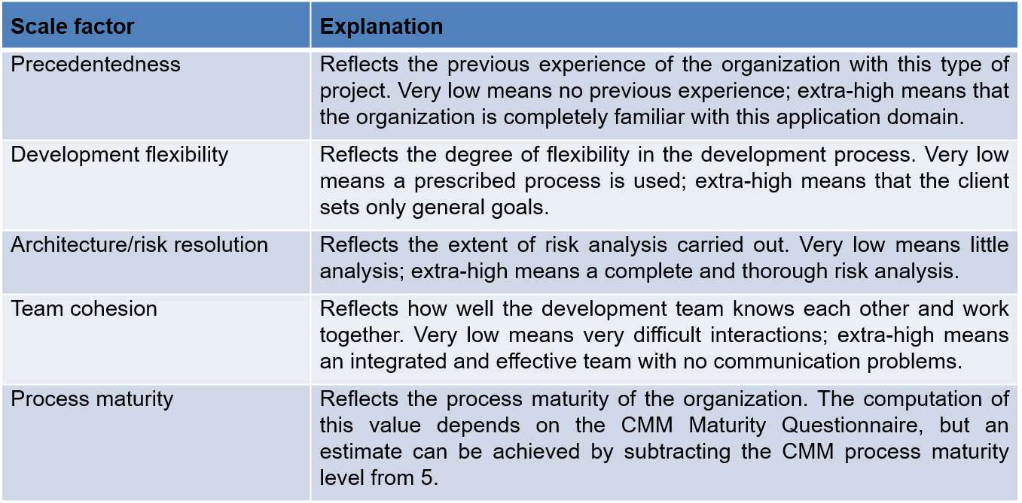
Software Pricing
COCOMO model: Post Architecture Model

Slide 130
Software Pricing
COCOMO model: Post Architecture Model
Product Factors
Required Software Reliability (RELY)
Data Base Size (DATA)
Product Complexity (CPLX)
Developed for Reusability (RUSE)
Documentation Match to Life-Cycle Needs (DOCU)
Platform Factors
Execution Time Constraint (TIME)
Main Storage Constraint (STOR)
Platform Volatility (PVOL)

Slide 131
Software Pricing
COCOMO model: Post Architecture Model
Personnel Factors
Analyst Capability (ACAP)
Programmer Capability (PCAP)
Personnel Continuity (PCON)
Applications Experience (APEX)
Platform Experience (PLEX)
Language and Tool Experience (LTEX)
Project Factors
Use of Software Tools (TOOL)
Multisite Development (SITE)
Required Development Schedule (SCED)

Slide 132
Software Pricing
COCOMO model: Schedule Estimation
The initial version of COCOMO II provides a simple schedule estimation capability
The initial baseline schedule equation for the COCOMO II
Time to Develop, TDEV, is the calendar time in months
TDEV = [C*(PM_{NS})^{(D+0.2*(E-B))}]*(SCED%/100)
C(3.67) is a TDEV coefficient
PMNS is the estimated PM excluding the SCED effort multiplier
D(0.28) is a TDEV scaling base exponent
E is the effort scaling exponent derived as the sum of project scale factors
B(0.91) as the calibrated scale factor base-exponent
SCED% is the compression / expansion percentage in the Required Development Schedule (SCED)

Slide 133
Software Pricing
COCOMO model: Maintenance Cost
The assumption made by the COCOMO II model is that software maintenance cost generally has the same cost driver attributes as software development costs.
There are some special considerations for using COCOMO II in software maintenance
The SCED cost driver (Required Development Schedule) is not used in the estimation of effort for maintenance. This is because the maintenance cycle is usually of a fixed duration.
The RUSE cost driver (Required Reusablity) is not used in the estimation of effort for maintenance. This is because the extra effort required to maintain a component’s reusability is roughly balanced.
The RELY cost driver (Required Software Reliabilty) has a different set of effort multipliers for maintenance. For maintenance the RELY cost driver depends on the required reliability under which the product was developed.

